Slide 1

More on Hypothesis Testing
CEE 465/CEWA 565 Fall 2019
Lecture 3

Slide 2
Where did the normal distribution come from?
Abraham de Moivre, 1721, a statistician who was a consultant to gamblers, wanted a formula to approximate the binomial distribution – the best fit was the Gaussian
Galileo and Gauss were both looking at errors in astronomical observations and noticed the errors were symmetric with more frequent small errors than large errors – in 1809, Gauss found the errors could be fit with the normal distribution
In 1810, Laplace published the central limit theorem, which shows that the means of repeated samples from any distribution are normal.
Check out this Online Stats Book (it has fun quizzes): http://onlinestatbook.com/2/index.html

Slide 3
Confidence Intervals

Slide 4




300 cm
250 cm
200 cm
150 cm
100 cm
50 cm

Slide 5


Dec 3, 2014: ?? cm ± ?? cm
50 cm
45 cm
40 cm
35 cm
30 cm
25 cm
20 cm
15 cm
You wrote your best guess (both parts).
Notes:
Ryan said 20 cm, so clearly Ryan vs. Jessica is worse than Teddy vs Eric.

Slide 6
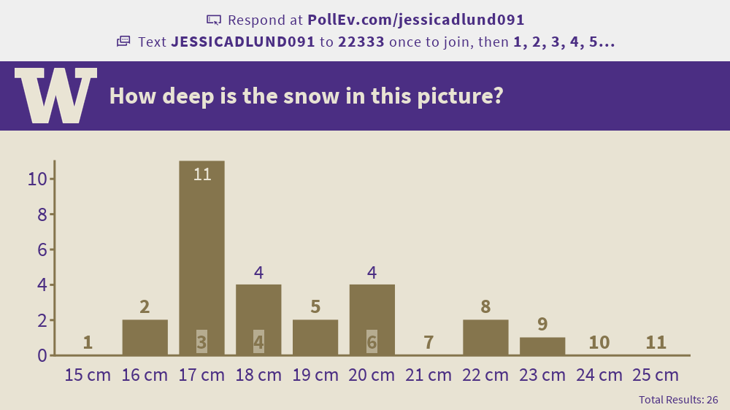
Sept 27, 2019 results

Slide 7
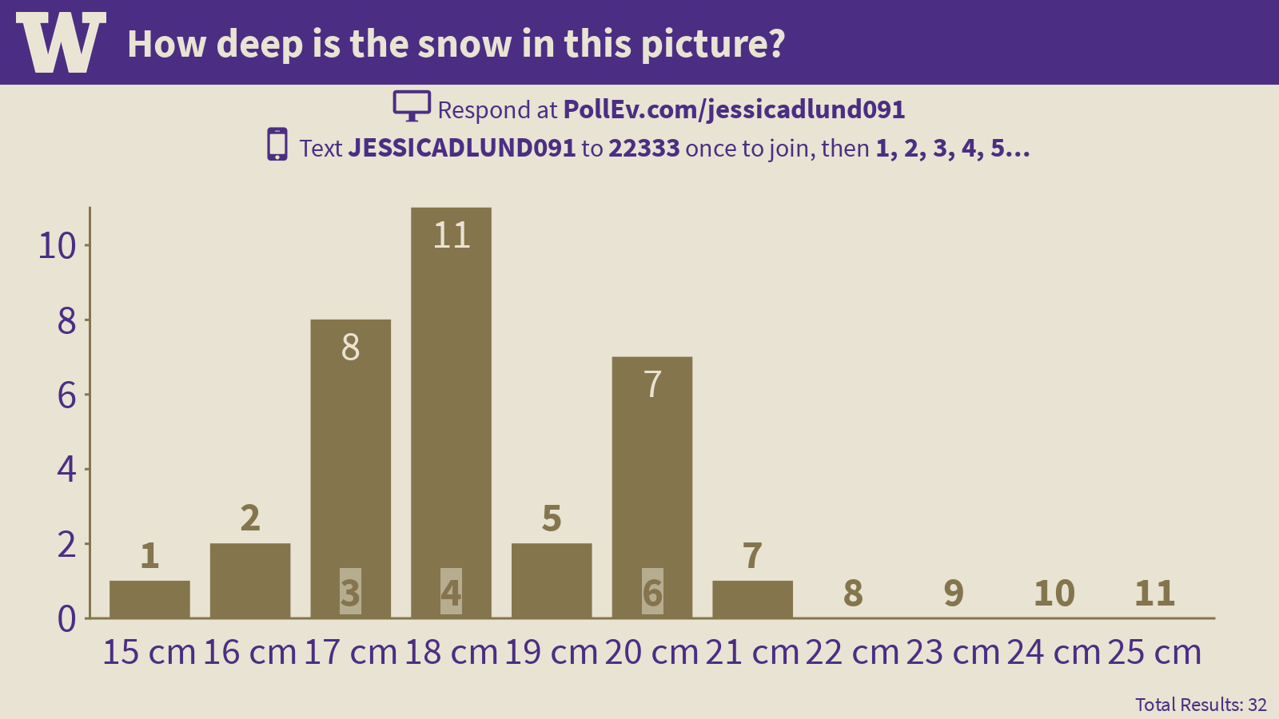
Results from Wednesday, September 26, 2018: Can we determine the certainty from the collection of best guesses?

Slide 8
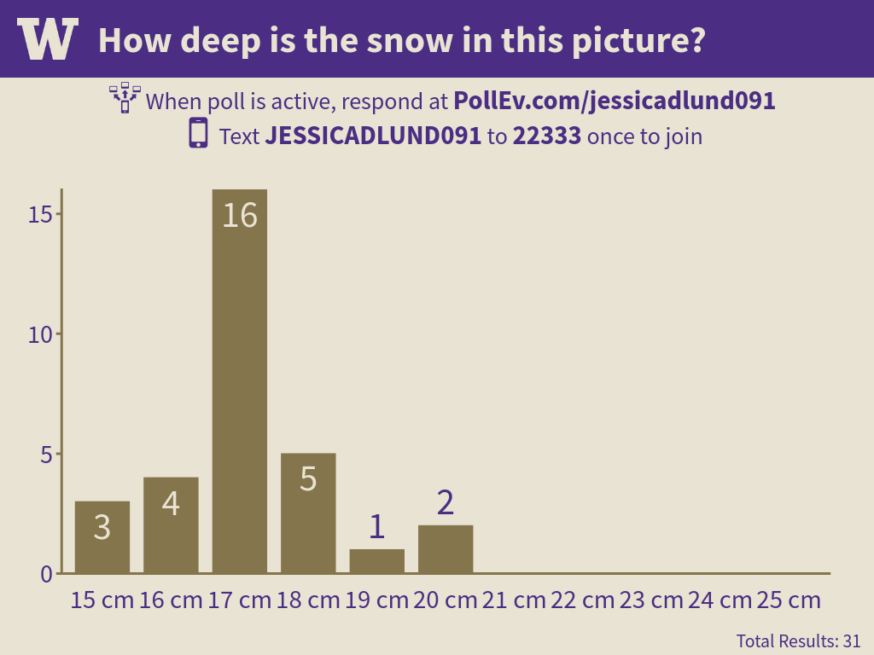
Results from Wednesday, September 27, 2017: Quite different: Any ideas why?

Slide 9
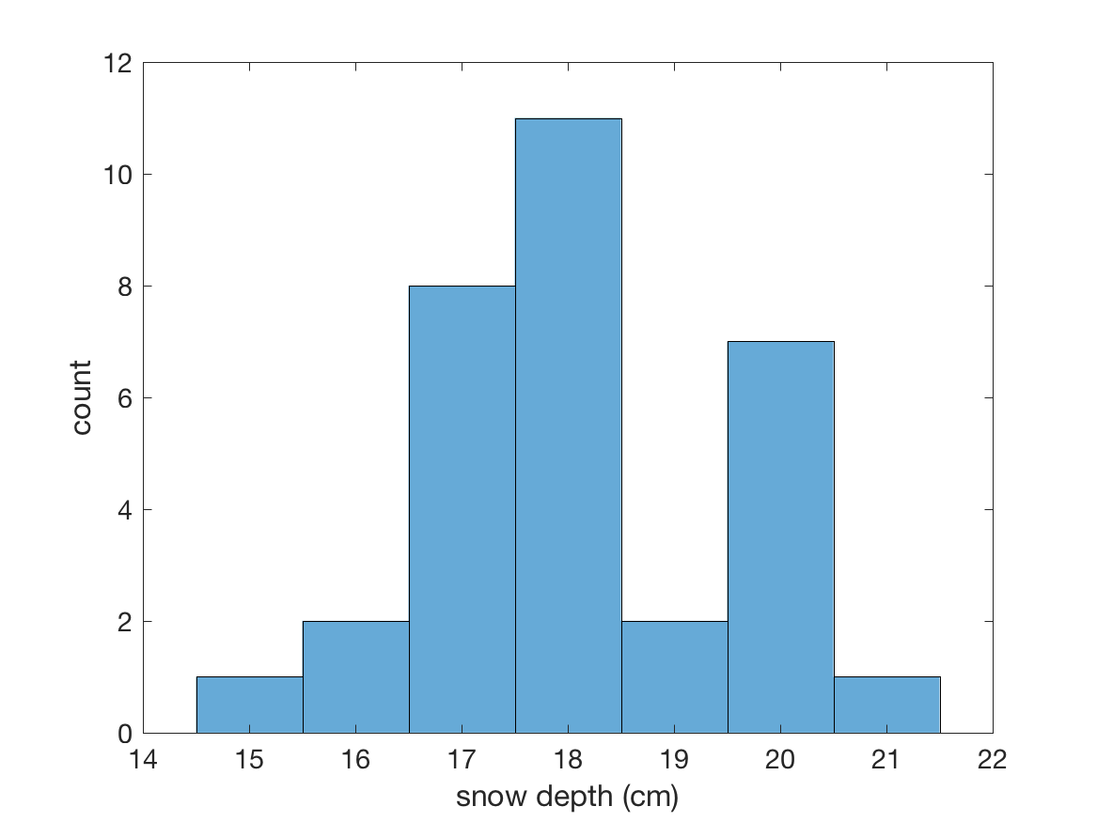
Confidence of “true value” from a distribution
How wide?
What certainty do we want?
95% confidence intervals?
90% confidence intervals?

Slide 10
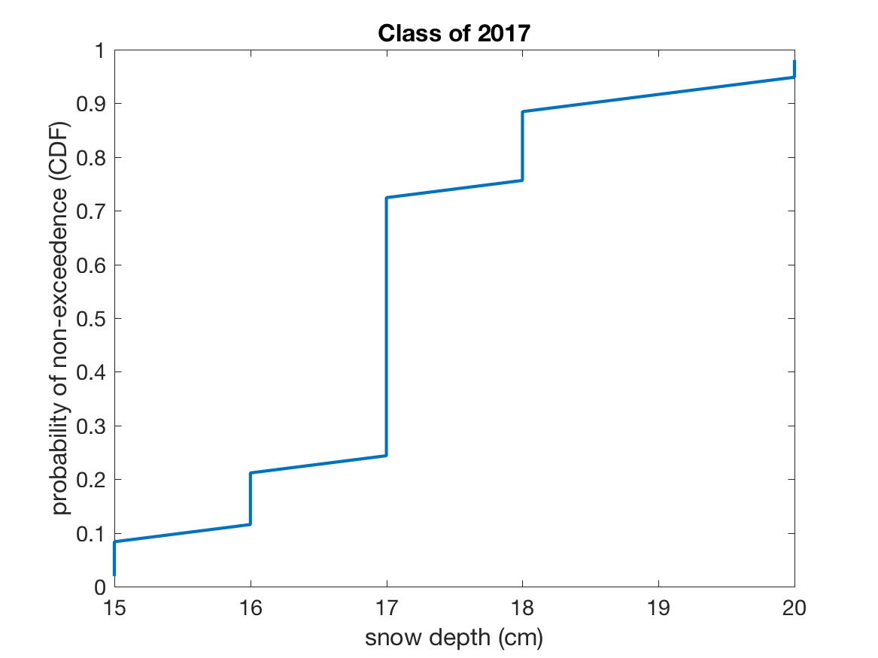
Apply Quantile Mapping (which we just learned)
Sort the answers in descending order
CDF_value = 1 – (rank - 0.4) /(num_samples + 0.2)
Plot snow depth vs. CDF_value, using the sorted snow depths

Slide 11
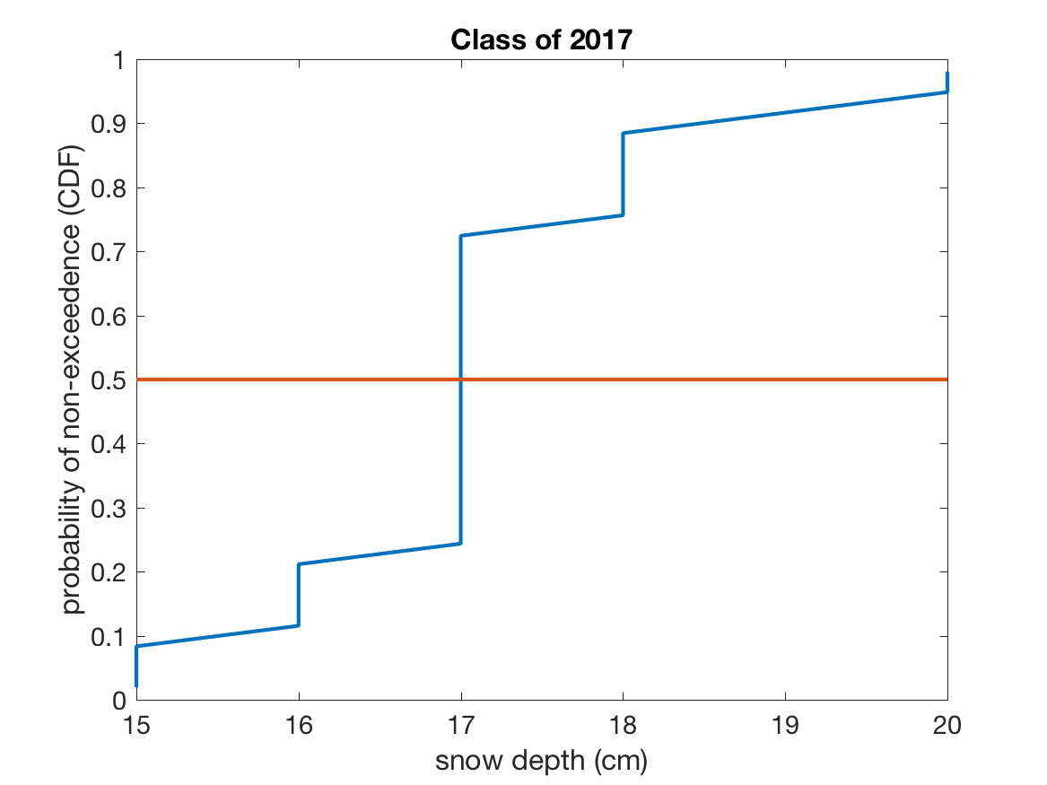
The CDF let’s us readily identify the median value:
Median = 17 cm

Slide 12
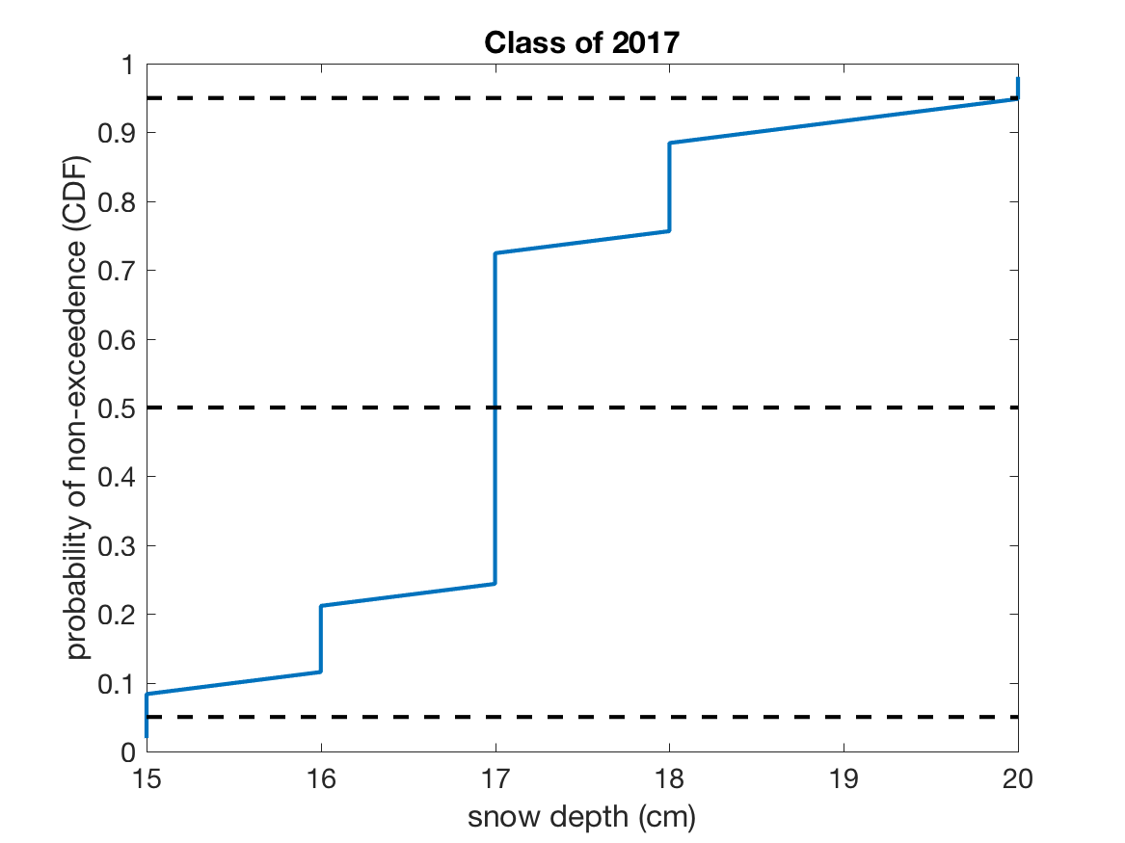
It also shows us confidence intervals:
What confidence interval is shown between these two dashed lines?

Slide 13
It also shows us confidence intervals:
What is the total probability of truth falling outside of these two dashed lines?

Slide 14
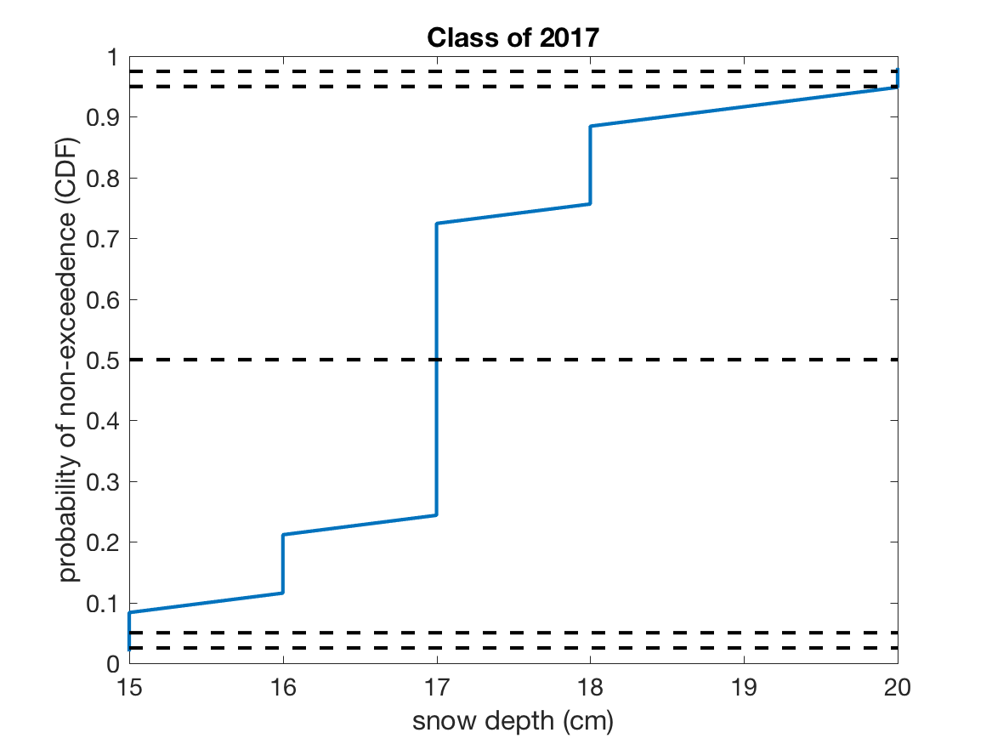
95% confidence is from 0.025 to 0.975.
95%
90%

Slide 15
What things should we notice about this graph?
95%
90%
15 to 20 cm (17 + 3 or -2 cm)

Slide 16
What things should we notice about this graph?
95%
90%
15 to 20 cm (17 + 3 or -2 cm)
1. Our confidence intervals are not symmetric.

Slide 17
What things should we notice about this graph?
95%
90%
15 to 20 cm (17 + 3 or -2 cm)
2. We would write the same confidence intervals for 90 or 95%.

Slide 18
What things should we notice about this graph?
95%
90%
15 to 20 cm (17 + 3 or -2 cm)
2. Our sample size does not resolve better than 90%.

Slide 19
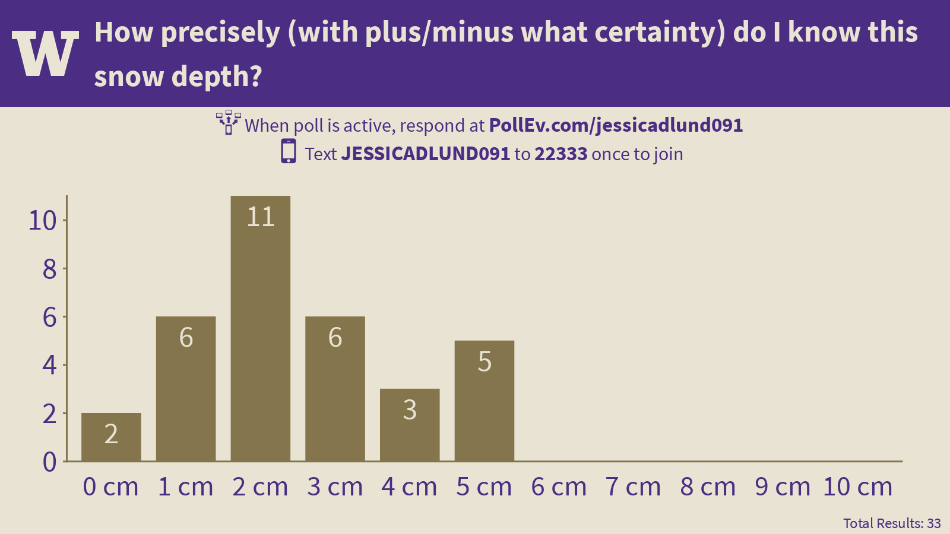
Do our collection of individual guesses on the certainty correspond to the confidence derived from our group’s collection of guesses for the true value?

Slide 20
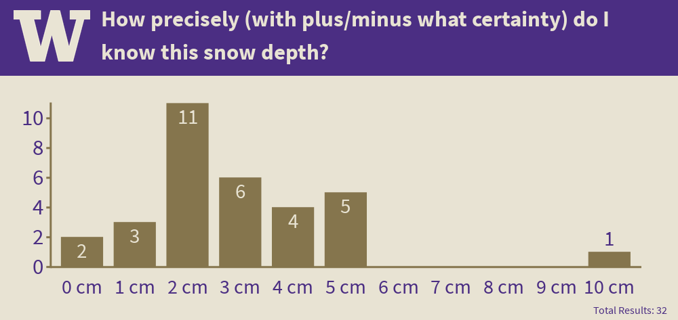
2019 Results: Most people said 2 cm, which agrees with the results from the distribution

Slide 21
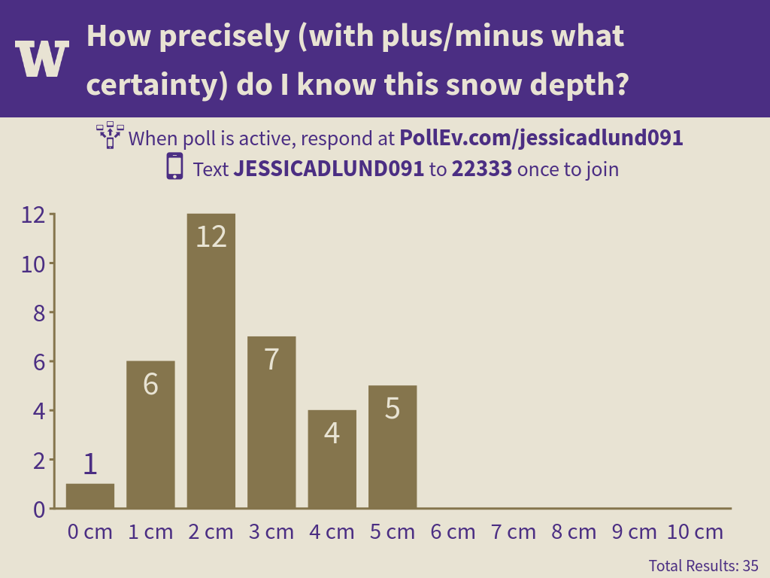
Last year’s class estimates on uncertainty were actually closer to this years than the mean values!

Slide 22
Hypothesis Testing

Slide 23
Hypothesis Testing in the Context of Systems Analysis
In a systems engineering context, testing hypothesis about changing statistical parameters can be thought of as “detective work,” using observed data to determine if a system is likely to have changed.
For example, flooding in forested mountain watersheds in the Pacific Northwest has been hypothesized to be affected by logging (e.g. due to increases in snowpack and increased soil moisture).
One way of attempting to support this hypothesis is to examine data before and after a substantial portion of a particular basin was logged, and evaluate whether the changes seen in the data are statistically significant or not. (HJ Andrews Streamflow Project.)
In inference testing we typically establish a null hypothesis (a mathematical statement), a set of alternative hypotheses, and a quantitative test procedure for rejecting the null hypothesis in favor of one of the alternative hypotheses:
We either:
reject the null hypothesis in favor of one of the alternative hypotheses, or
do not reject the null hypothesis.

Slide 24
I ask students to look at the snow pole every year. I hypothesize that different classes will come up with different means because seeing the graph in poll everywhere influences the votes. [Note: I came up with this hypothesis before looking at the data.] Null Hypothesis: ???

Slide 25
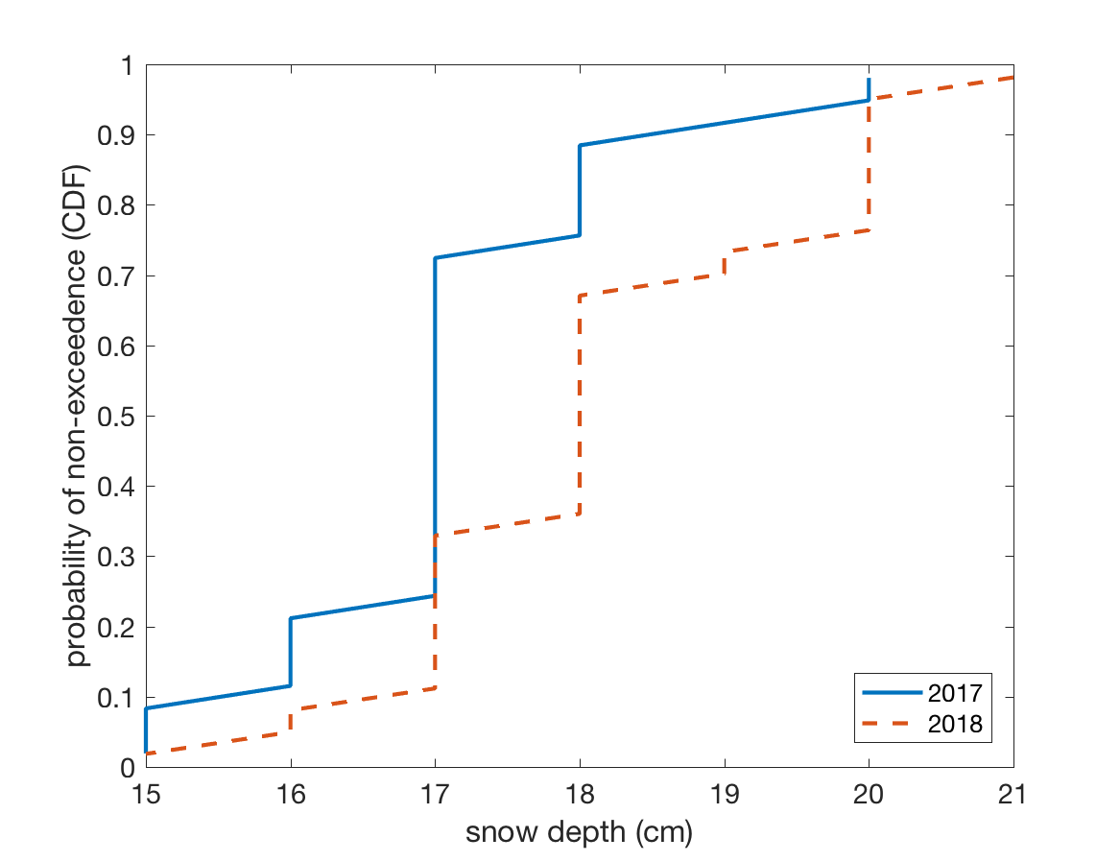
Median increased from 17 to 18 cm. Is that significant?

Slide 26
Type I and Type II Errors
At least two potential kinds of errors exist:
Type I Error: We reject the null hypothesis when in fact it is true.
In most hypothesis testing the Type I error is selected prior to conducting the tests. The probability of a Type I error is usually represented by the symbol α. The Confidence of the test is (1 – α). E.g. if the Type I error is 0.05 then the confidence is 0.95.

Slide 27
Type I and Type II Errors
Type II Error: We do not reject the null hypothesis when in fact it is false.
Type II error is usually represented by the symbol β, and the quantity (1 – β) is called the Power. The Power is the likelihood that we would successfully avoid a type II error for a given assumption of the true nature of probability distribution. I.e. the Power is the likelihood that we would correctly conclude that a change in the probability distribution had taken place, if in fact a change of a certain assumed magnitude had occurred.
The Type II error is a function of α and the posited true nature of the probability distribution we are hoping to detect (i.e. we decide how different the true probability distribution is from the null hypothesis, and then see how likely we would be to make a mistake ).

Slide 28
The outcome of our study
 | We reject the Null Hypothesis | We do not reject the Null Hypothesis
Null Hypothesis is True | Type 1 Error | Success!
Null Hypothesis is False | Success! | Type 2 Error
The true world

Slide 29
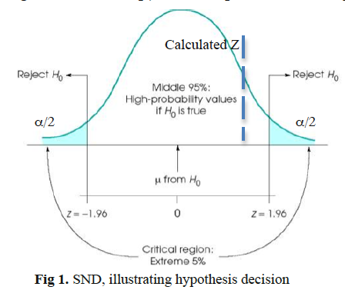
If H₀ is the true mean, there’s only a 5% chance that the value legitimately fell in the tails of the distribution. So, if you reject the null hypothesis, there’s only a 5% chance that you were unfairly doing this, and thus you have 95% confidence that you’re correct to reject it. That’s Type I error.
In case shown here, we don’t reject the null. What if we should have rejected the null hypothesis? That’s Type II error (more on that later, but note that ATMS552 pdf 1 in 20 chance on type II error is a typo, first mention should be type I error).
From Hypothesis testing Summary.pdf (notes from Erkan’s Advanced Hydrology Class)

Slide 30
Inferences Regarding Changes in the Mean

Slide 31
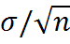
Inferences Regarding Changes in the Mean
In these problems, we typically have at our disposal a sample data set with:
a sample size of n
a sample mean
and a sample standard deviation (i.e. the variance is )
Restatement of the Central Limit Theorem (see http://en.wikipedia.org/wiki/Central_limit_theorem):
If a sample of n values is extracted at random from a population with mean μ and standard deviation σ, and n > 30, then the means of these samples are approximately normally distributed and have a standard deviation of:
Thus we can test whether our sample with mean is likely to have come from a hypothesized population with a “true” mean μ and standard deviation σ. (Value in this is that means are normally distributed even when original distribution is not!)

Slide 32
The Central Limit theorem tells us we can use the normal distribution for any large sample hypothesis testing about changes in the mean
Percentile
z = 1.65
This is z for an alpha of 0.05.
z
A normally distributed number can be expressed as x = μ + z*σ , where z is called the “standard normal variate” (i.e. the number of standard deviations from the mean).

Slide 33
So, on homework 1, we plotted CDFs of our peak streamflow data vs. the CDF for a normal distribution. Did our data look normally distributed?

Slide 34
So, on homework 1, we plotted CDFs of our peak streamflow data vs. the CDF for a normal distribution. Did our data look normally distributed? So, if we want to test for a change in the mean value of peak streamflow (HW 2), can we use statistical tests designed for the normal distribution?

Slide 35
Large Sample Tests

Slide 36
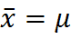
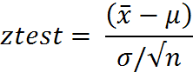
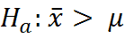
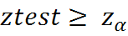
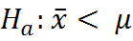
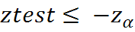
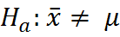
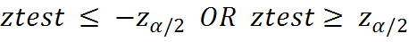
Single Sample Test:
Null Hypothesis:
Let α = Probability of a Type I error.
Test statistic: (i.e. number of standard deviations from the mean)
Alternate Hypothesis: Rejection Region:
one-sided
one-sided
two-sided

Slide 37
Should it be 1-sided or 2-sided?
See page 104-106 of Helsel and Hirsch.pdf

Slide 38
I ask students to look at the snow pole every year. I hypothesize that different classes will come up with different means because seeing the graph in poll everywhere influences the votes. [Note: I came up with this hypothesis before looking at the data.] Should this test be one or two sided?

Slide 39
What should alpha be?

Slide 40
Significance Level
The significance level associated with a given set of sample statistics (often denoted P) can also be calculated.
Definition:
For a given set of sample statistics, P is defined as the lowest value of α for which the null hypothesis would be rejected.
*Note that if P is smaller than α, then the null hypothesis would be rejected.
(Although see notes from Professor Hartmann saying that you must always state the significance value before you calculate P statistic or he will call you a “mush-headed scoundrel.”
Also, recent set of articles on the p-value from the American Statistical Association – will discuss more next week.)

Slide 41
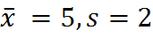
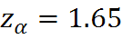
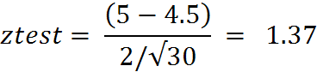
Example:
Suppose from a sample data set of size n = 30 we calculate:
Is this sample mean statistically different from 4.5 for α = 0.05 if s=2 ?
So we cannot reject the null hypothesis.
By looking up 1.37 in the standard normal distribution CDF we find P, the value of α for which the null hypothesis would be rejected. In this case P = 1 - 0.915 = .085

Slide 42
Test statistic falls to the left of the cut-off. This mean could occur by chance from the same true distribution.
Percentile
z = 1.65
This is z for an alpha of 0.05.
z = 1.37
z
A normally distributed number can be expressed as x = μ + z*σ , where z is called the “standard normal variate” (i.e. the number of standard deviations from the mean).

Slide 43
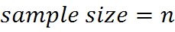
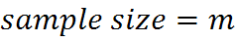
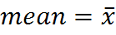
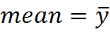
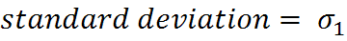
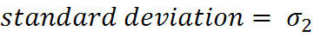
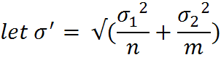
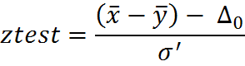
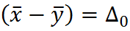
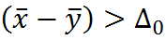
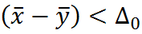
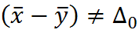
Two Sample Test:
Sample 1: Sample 2:
Then provided n and m are both larger than about 30,
is normally distributed.
The null hypothesis:
Alternate hypotheses:

Slide 44
Estimating Type II Error:
How likely are we to fail to reject the null hypothesis when in fact it is false?

Slide 45
REVIEW:
If H₀ is the true mean, there’s only a 5% chance that the value legitimately fell in the tails of the distribution. So, if you reject the null hypothesis, there’s only a 5% chance that you were unfairly doing this, and thus you have 95% confidence that you’re correct to reject it. That’s Type I error.
In case shown here, we don’t reject the null. What if we should have rejected the null hypothesis? That’s Type II error.
From Hypothesis testing Summary.pdf (notes from Advanced Hydrology Class)

Slide 46
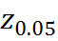
Any time our calculated value falls to the left of z0.05, we accept the null hypothesis.
Null hypothesis PDF

Slide 47
Pretend we know the true distribution and can plot the true, “actual” PDF.
Posited “Actual” PDF
Null hypothesis PDF
In which region of the “actual” pdf would we accept the null? Color it.

Slide 48
Pretend we know the true distribution and can plot the true, “actual” PDF.
Posited “Actual” PDF
Null hypothesis PDF
In which region of the “actual” pdf would we accept the null? It’s colored!

Slide 49
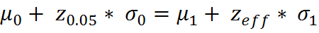
Estimating Type II Error (play with graphs on normal distribution excel file, 2nd tab):
Posited “Actual” PDF,
With mu_1 and sigma_1
Null hypothesis PDF
With mu_0 and sigma_0
Where does the “true” curve intersect the z0.05 of the null curve?

Slide 50
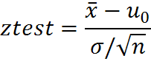
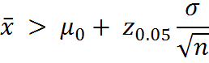
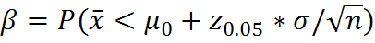
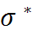
Estimating Type II Error for a Single Sample Test:
Recall that :
Thus for an upper tail test with α=0.05, we would reject the null hypothesis if
Thus the Type II error is:
Assuming is a normally distributed sample with a true mean of
and a true standard deviation of .

Slide 51
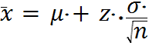
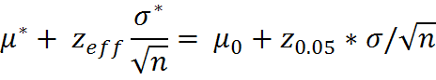
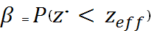
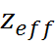
Estimating Type II Error for a Single Sample (cont.)
We here assume we know the true mean and standard deviation of
Therefore we can express an arbitrary sample mean as:
Expressing the original rejection threshold in the new probability distribution we obtain:
(equation 1)
(Note that this is essentially “looking up” the rejection threshold for the null hypothesis in the assumed true probability distribution.)
Finally we note that:
which we can easily obtain by solving for in equation 1 above, and then looking up the associated value in the CDF for the standard normal distribution.

Slide 52
Use the normal CDF to look up the probability of the test value being < z_eff
Which z value (z_eff) is this?
Posited “Actual” PDF,
With mu_1 and sigma_1
Null hypothesis PDF
With mu_0 and sigma_0
Where does the “true” curve intersect the z0.05 of the null curve?

Slide 53
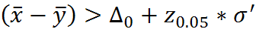
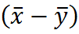
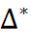
Estimating Type II Error for a Two Sample Test:
Recall that :
Thus for an upper tail test with α=0.05, we would reject the null hypothesis if
Thus the Type II error is:
Assuming is a normally distributed sample with a true mean of
and a true standard deviation of .
See Ch 9 from Devore Stats book.

Slide 54

Estimating Type II Error (cont.)
We here assume we now know the true mean and standard deviation of
Therefore we can express an arbitrary difference of the two sample means as:
Expressing the original rejection threshold in the new probability distribution we obtain:
(equation 1)
(Note that this is essentially “looking up” the rejection threshold for the null hypothesis in the assumed true probability distribution.)
Finally we note that:
which we can easily obtain by solving for in equation 1 above, and then looking up the associated value in the CDF for the standard normal distribution.

Slide 55
Type II Error: But if you’re making up the “true” distribution you’re missing, what are you doing anyway? Why???

Slide 56
Type II Error: But if you’re making up the “true” distribution you’re missing, what are you doing anyway? Why???
Remember that we’re engineers.
What mistakes can we not afford to make? For example, if peak flows increased by some amount, a flood might wipe out a city or overtop a dam. What is the chance that we’re missing something critical in our baseline assumption that nothing has changed?
Which level of “true” change would cause you to take a different management action?

Slide 57
Small Sample Tests Using the T Distribution

Slide 58
Applications
The T distribution may be used if the sample sizes are smaller than about 30 , however the two populations must be normally distributed (or at least reasonably close to normally distributed).
The T statistic is selected based on the Type I error (α) and the number of degrees of freedom, which is determined by the sample size.
Table of values:
See stats_tables.PDF in the files folder for Week 2 on Canvas.
http://www.sjsu.edu/faculty/gerstman/StatPrimer/t-table.pdf

Slide 59




Single Sample Test:
Null Hypothesis:
α = Probability of a Type I error, number of degrees of freedom = (n-1)
Test statistic:
Alternate Hypothesis: Rejection Region:
u = μ here

Slide 60
Single Sample Test Example:
Null Hypothesis: True mean is 0. We have a sample of 10 numbers, with a sample mean of 2 and sample standard deviation of 1. They seem close to normally distributed.
Quick question: Based on our homework, can we tell if 10 numbers are normally distributed?
α = Probability of a Type I error (we set this at 5%), number of degrees of freedom = (n-1)
Test statistic:
Alternate Hypothesis: Rejection Region:
u = μ here
t = 2/(1/sqrt(10)) = 6.32
And what if the standard deviation were 2?
t = 3.16 (use stats_tables.PDF)

Slide 61




Two Sample T tests:
Pooled estimator of S:
Null Hypothesis:
Test Statistic:
Alternate Hypothesis: Rejection Region:
Ha:
Here we are assuming that the true variance of the two populations is the same.

Slide 62



Two Sample T tests for Different Standard Deviations and Sample Sizes.
Number of Degrees of Freedom:
Null Hypothesis:
Test Statistic:
Alternate Hypothesis: Rejection Region:
Ha:

Slide 63
y
x
 | first guess | second guess
 | 17 | 17
 | 18 | 18
 | 18 | 18
 | 15 | 18
 | 18 | 18
 | 22.5 | 20
 | 17 | 19
 | 17.5 | 18
 | 15.5 | 17.5
 | 19 | 18
 | 18 | 18
 | 17.5 | 17.5
 | 17.5 | 18
 | 20 | 18
 | 17.5 | 18
 | 17 | 18.5
 | 17 | 19
 | 20 | 18
 | 17.5 | 18
Mean | 17.9 | 18.1
Mode | 17.5 | 18.0
Median | 17.5 | 18.0
Standard Deviation | 1.7 | 0.6
m = n = 19
I get 22.4
=0.2 / 0.4
= 0.5

Slide 64

0.5 is not larger than 1.7. Do not reject the null.
From stats_tables.PDF

Slide 65
Inferences Regarding the Standard Deviation

Slide 66

Inferences Regarding the Standard Deviation:
The central limit theorem does not apply to random samples of the variance from a population; however, assuming an underlying normal distribution, we can test some hypotheses regarding the variance of a sample:
Single sample test from a population with “known” standard deviation:
Let X1, X2, . . . ,Xn be a random sample from a normal distribution with parameters μ and σ
Then the test statistic:
Is Chi Squared distributed with n-1 degrees of freedom.
Tables (see 2nd page of stats_tables.PDF on canvas, or):
http://www.itl.nist.gov/div898/handbook/eda/section3/eda3674.htm
http://www.stat.tamu.edu/~west/applets/chisqdemo.html

Slide 67


Using this approach we can broadly test the hypothesis that an arbitrary sample variance is from the population with assumed known variance.
Example:
Suppose we have a long record of temperature at a station from which we estimate:
A shorter period of 20 years at the end of the record has a sample standard deviation:
Does this sample statistic suggest a statistically significant change in the standard deviation at this station location?

Slide 68
Using this approach we can broadly test the hypothesis that an arbitrary sample variance is from the population with assumed known variance.
Example:
Suppose we have a long record of temperature at a station from which we estimate:
A shorter period of 20 years at the end of the record has a sample standard deviation:
Does this sample statistic suggest a statistically significant change in the standard deviation at this station location?
=39.26 -- we have n-1, or 19 degrees of freedom and want 95% confidence if we reject

Slide 69


Slide 70






Null hypothesis:
Alternate hypothesis:
Confidence level :
Rejection region:
Where,
So, yes, the statistics from this sample suggests a statistically significant change in the standard deviation at this station.

Slide 71
Non-Parametric Tests for Change in the Mean

Slide 72

Note:
P 105 Hershel and Hirsch has a nice summary of all the different tests available
– we only have time to cover some of them here.

Slide 73
When should you choose a parametric test vs. a non-parametric test?

Slide 74
When should you choose a parametric test vs. a non-parametric test?
Parametric: Use when you’re confident your data are normally distributed
Non-Parametric: Use when the data are not normally distributed
Question: What if I just can’t tell either way? It’s okay to run both tests. If they give you the same result, you feel better. If not, then you need to think about about it some more…

Slide 75

What’s the penalty for picking the wrong test (other than having reviewers and stats experts look down on you)?
Improperly using a Parametric test will tend to increase your Type II error.
P 107 Hershel and Hirsch

Slide 76

Sign Test:
Let:
If the sample mean is equal to an assumed null hypothesis population mean, then we would expect the positive and negative anomalies from the sample to be about equal. With an increasing number of either positive or negative anomalies, it becomes increasingly less likely that the null hypothesis is true.

Slide 77



Sign Test for Small n
Null Hypothesis:
Test statistic:
Alternate Hypothesis: Rejection Region:
The critical values are extracted from the Binomial distribution Bin(n, 0.5) that corresponds to the level of alpha. (see stats_tables.PDF , page 3 for the Binomial tables)
Remember: For null to be true, about 50% should exceed the mean…

Slide 78
Example for n = 20
Notes:
This is the binomial distribution, binomial for tossing a coin, p=0.5, there’s a table for every sample size.

Slide 79
Wilcoxon Signed Rank Test:
For an assumed symmetric distribution shape, the Wilcoxon Signed Rank Test may be used. There is some loss of generality in comparison with the sign test (which assumes only continuity), but the performance is also better, closely approximating the performance of the T test for the normal distribution, and performing much better for more skewed or heavy-tailed distributions.
The basic idea is to calculate the anomalies (relative to the mean) for all the data points, and record their sign. Then rank the absolute value of the anomalies from lowest to highest. Finally sum the ranks of all the positive anomalies. In the case of ties, we assign each value in the tie the average rank
Example Data (see Excel File, Wilcoxan_rank_sum.xlsx):

Slide 80








Single Sample Wilcoxon Signed Rank Test: (this one not in Helsel &Hirsch)
Null Hypothesis:
Calculate and rank:
Test statistic:
Alternate Hypothesis: Rejection Region: (use c values in table A.9 in
stats_tables.PDF for small sample)
For n > 20 is normally distributed
NOTE TO JESSICA: This needs a continuity correction. Where is this from?

Slide 81



Two Sample Wilcoxon Rank-Sum Test (see excel file):
(See page 118 in Helsel and Hirsch)
Let X and Y be two sample data sets with sample size m and n respectively. For small sample tests, let the smallest sample be labeled X.
Null Hypothesis: The median of two groups is the same, so
H₀: Prob[x > y] = 0.5
Calculate and rank: Rank all of the values in the combined sample, keeping track of which came from which group.
Test statistic:
Alternate Hypothesis: Rejection Region: (use Table A.10 for small sample)
H₁: Prob[x>y] ≠ 0.5 (2-sided test)
H₂: Prob[x>y] > 0.5 (1-sided, x expected larger than y)
H₃: Prob[x>y] < 0.5 (1-sided, x expected smaller than y)
Note to Jessica, update lab and homework, etc. to tell people to use Matlab ranksum function, which is correct.
Notes:
Need correction. Add continuity correction, see page 120 on H&H

Slide 82

Two Sample Wilcoxon Rank-Sum Test (see excel file): (See page 118 in Helsel and Hirsch)
If both n_x and n_y are greater than 10, we can use a normal approximation for the test statistic.
From notes on matlab ranksum() function…

Slide 83

We need the continuity correction because W is actually a binomial distribution (integer number of counts one group is larger). The normal distribution is continuous (not just integers).
P 122 of Helsel and Hirsch.
Also see: http://www.statisticshowto.com/what-is-the-continuity-correction-factor/

Slide 84
MonteCarlo Simulation

Slide 85
Inference Testing Using Monte Carlo Simulation:
Assuming a particular probability distribution, Monte Carlo Simulation can be used to construct an arbitrarily large set of M random samples (each with a finite sample size n).
For any test statistic (e.g. μ, σ) that can be calculated from these sample data sets we can easily construct a set of empirical values defining a rejection region with Type I error α.
Procedure for independent (i.e. non-autocorrelated) data:
Create M random samples, each of sample size n.
Calculate the test statistic of interest for each sample.
Rank the M test statistics
Using the Cunnane unbiased quantile estimator, construct the CDF of the M sample test statistics.
Extract the appropriate quantile associated with the Type I error α. E.g. extract the 5th or 95th percentile from the CDF for α = 0.05 for a one-tailed test.
Compare the test statistic from another data set (with sample of size n), to this rejection value.

Slide 86

Monte Carlo Type II Error Analysis:
By constructing N samples of m values from a known probability distribution, we can also estimate the Type II error associated with our Monte Carlo inference test based on a given α from the previous page.
Procedure:
Construct a large random sample with a known change in μ and/or σ.
Calculate the test statistic of interest for each of these samples.
Count how many of these sample statistics are outside the rejection region for a given α and change in μ and/or σ using the Monte Carlo analysis from the previous page.
The fraction of the samples outside the rejection region, divided by the total samples is an estimate of Β. I.e.

